Slide 1
Case Study Final: Pokemon Statistics
Rohan Jay Arun

Slide 2
What the presentation covers
Graphs
Exploratory Data Analysis
Data Transformation
This Data set had lots to explore
Mainly graphs using tidyverse and ggplot

Slide 3
Limitations
Data is outdated (Only has till 5th generation of pokemon) with only 721 Pokemon
There are currently 898 Pokemon
Not too familiar with accuracy of the pokemon
Dataset is 5 years old

Slide 4
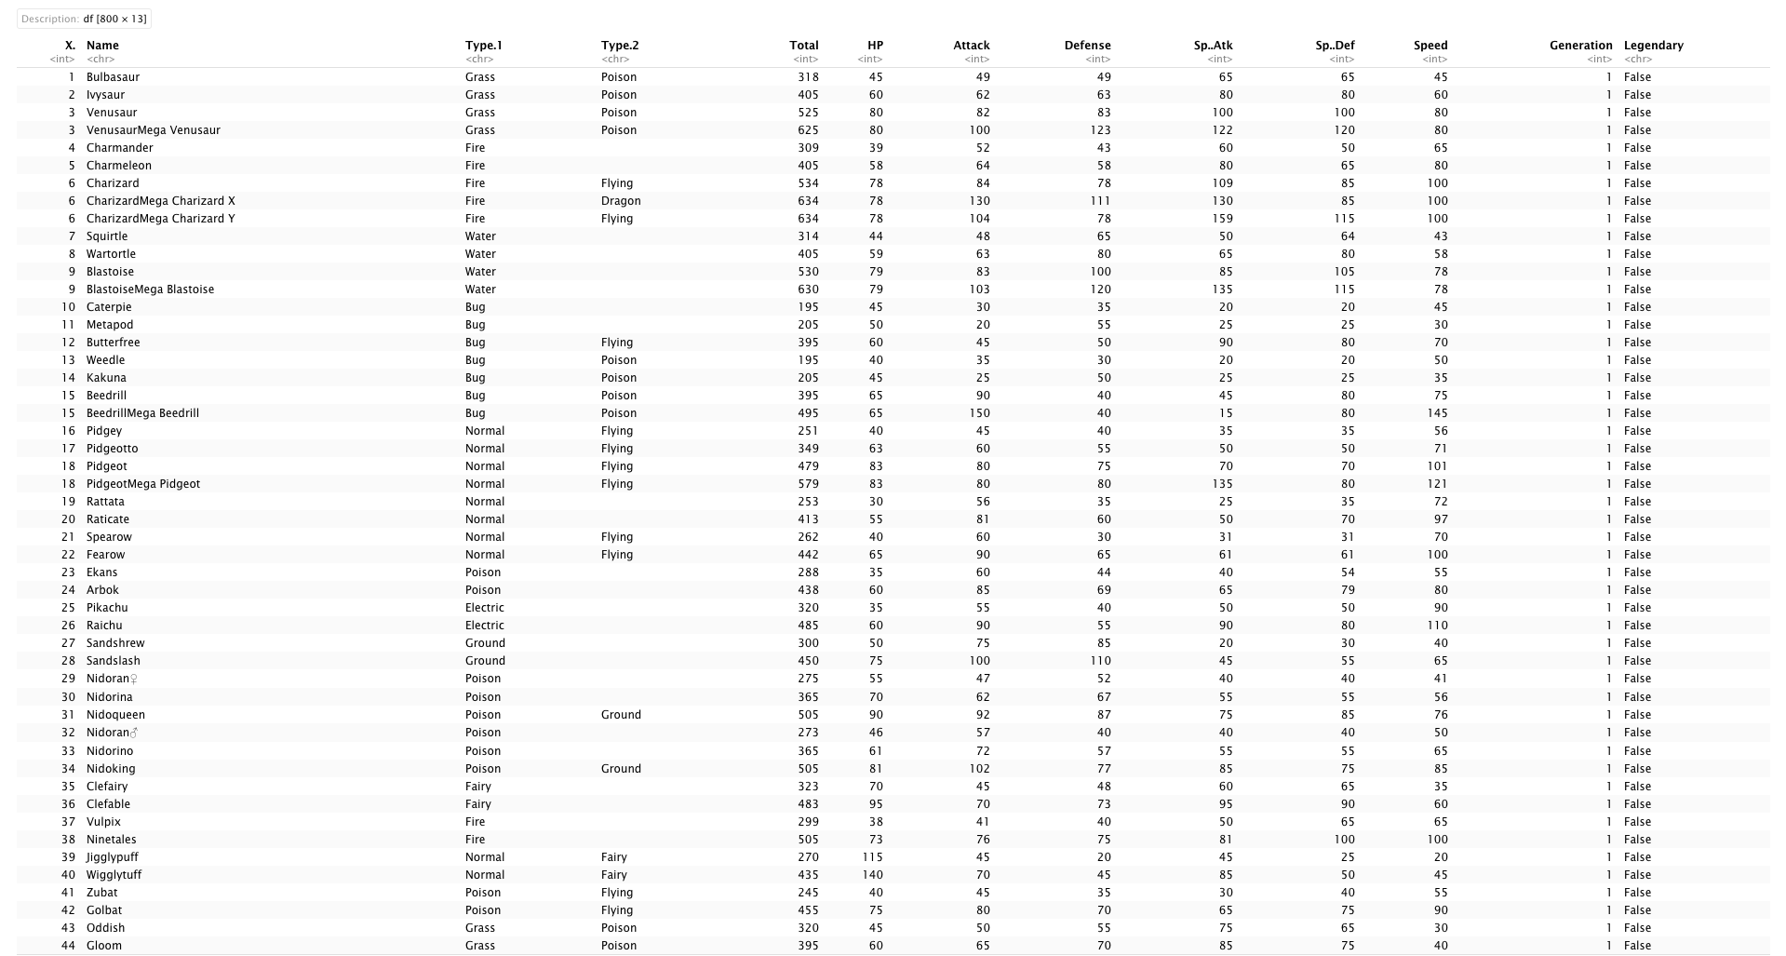
DATA FORMAT

Slide 5
Exploratory Data Analysis
Pokemon is a popular franchise with teenagers and young adults.
It is a game with multiple pocket monsters which you train and battle with
Each Pokemon is unique and has different stats
I replaced all the empty columns with “None” and added an extra dataset combining both of the types.

Slide 6
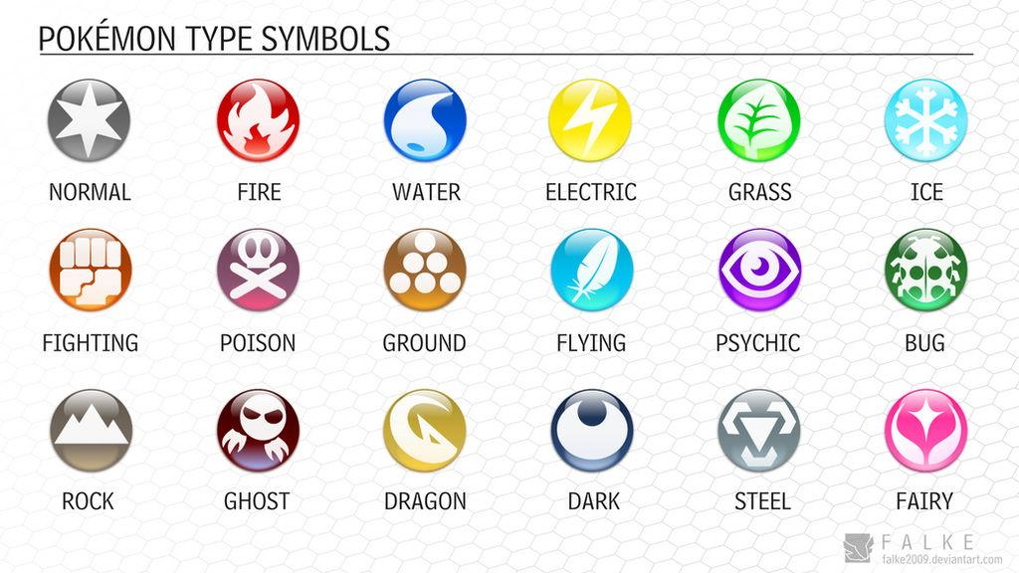

Slide 7
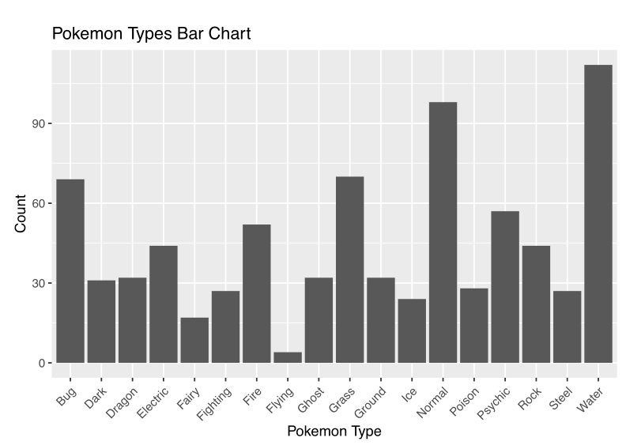
Mostly Water and Normal Type pokemon

Slide 8
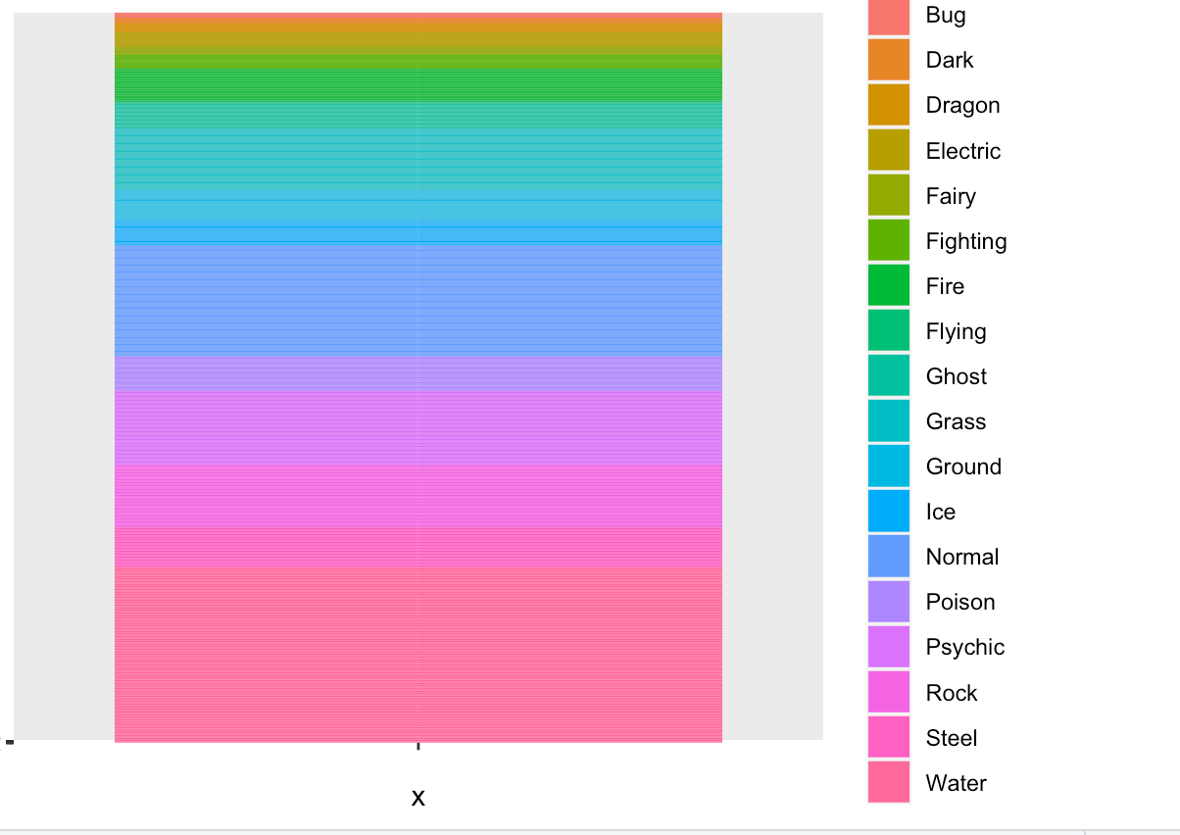

Slide 9
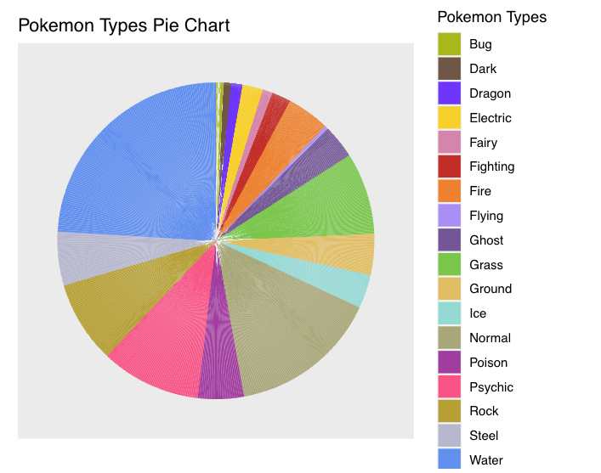

Slide 10
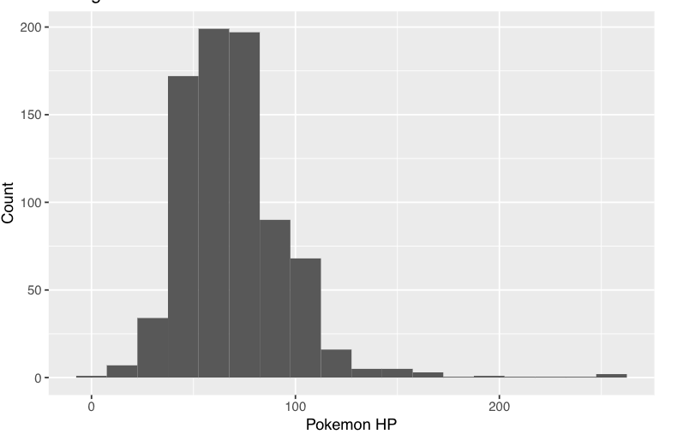

Slide 11
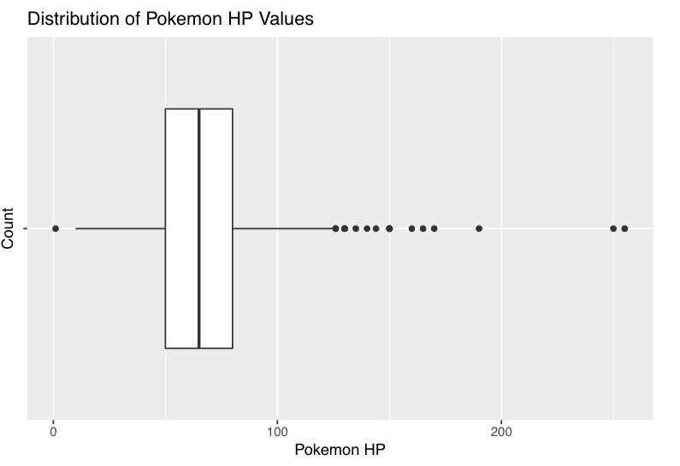

Slide 12
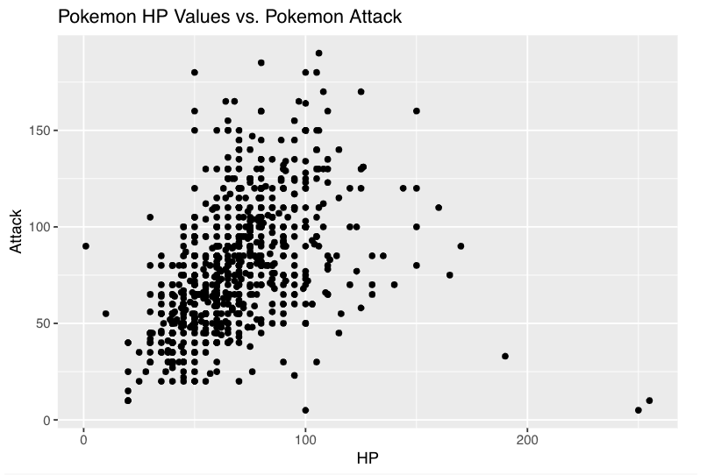

Slide 13
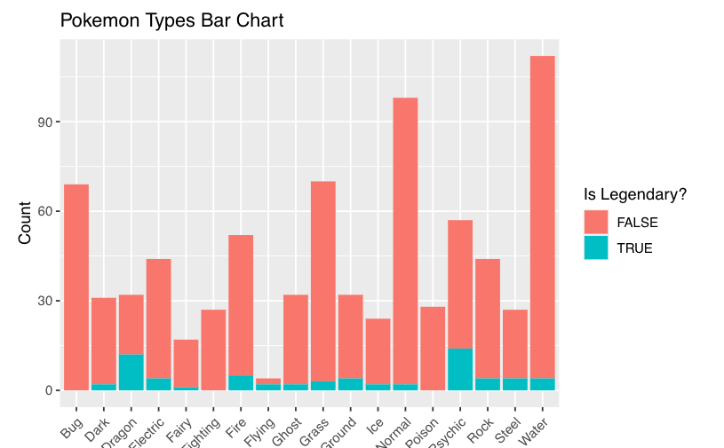

Slide 14
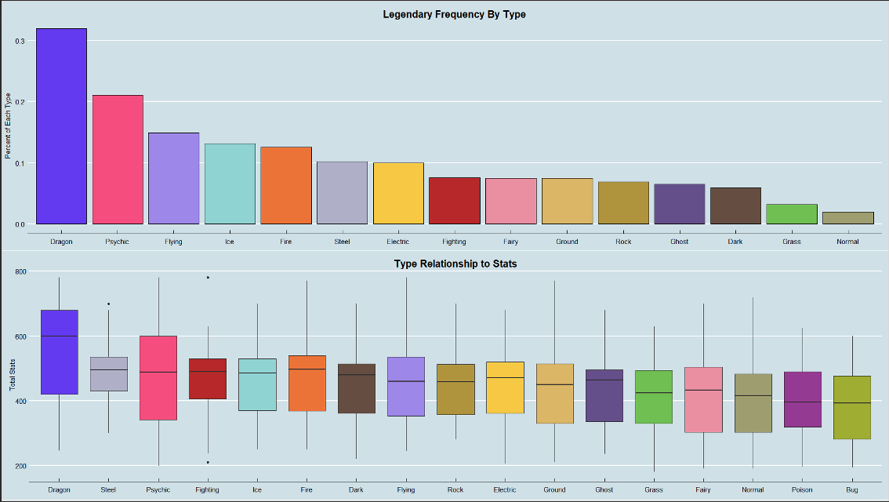

Slide 15
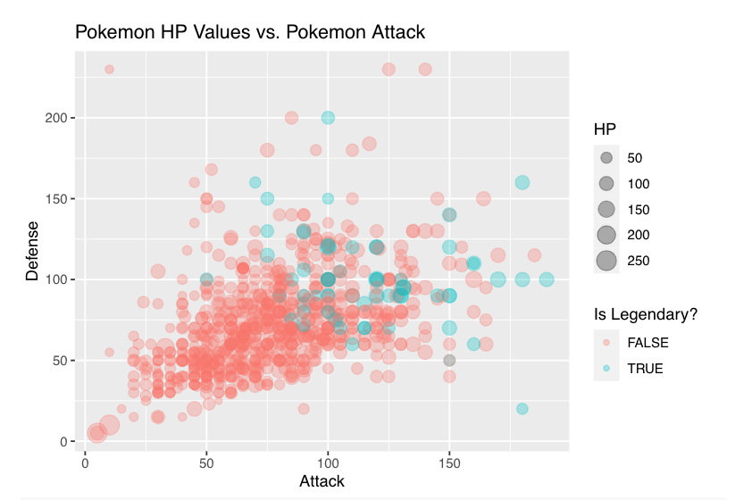

Slide 16
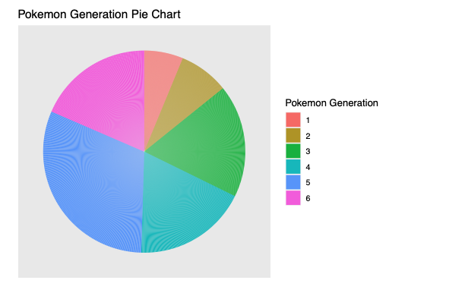

Slide 17
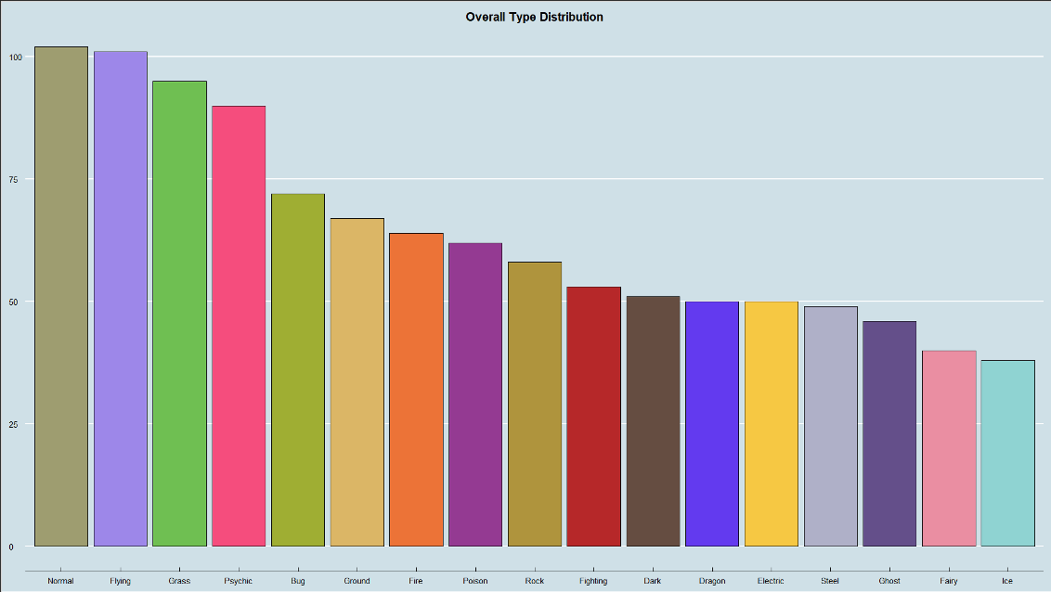

Slide 18
Conclusion/Observations
Legendary, mega, and mythical pokemon have a strong indicator of being higher power
Bug-Poison Type have the lowest power
There are many Dragon and Psychic Legendary pokemon
No Bug Fighting or Poison Legendary pokemon
Majority of the pool comes from the 5th generation

